Slide 1
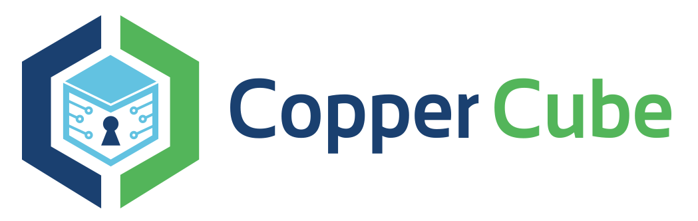
Blockchain Security
Ramesh Krishnasagar

Slide 2
A - Plan
Introduction – Clear with fundamentals
Ethereum & Quorum
Security issues, solution and best practices

Slide 3
Today’s Agenda
Introduction
Why Blockchain?
What is a Blockchain?
Centralized and Decentralized
Value & Asset management using Blockchain
DLT
Hashing
Blocks and chaining

Slide 4
Today’s Agenda cont..
Consensus
Ethereum
Smart contracts
DAOs/DACs
Blockchain projects
Blockchain Biz cases

Slide 5
Introduction
Having accurate information and way to verify the sources of things when you are dealing in a situation of transaction of value is essential?
So we need a reliable system that we can trust
Todays world
Internet fraud
Malware
Cyber attacks on banks/ISP
Lack of transparency /fantastic net neutrality
How can we trust the integrity & quality of the information we are getting?

Slide 6
Introduction cont..
The answer is Blockchain
It can provide us a single source of truth
Tamper proof
Verifiable
Can’t change

Slide 7
What is Blockchain?
Definition of Blockchain
“Blockchain is a continuously growing decentralized ,digital ledger which keeps a permanent record of all the transactions that have taken place ,in a secure chronological and immutable way”

Slide 8

What is Blockchain?
It is ledger
Continuously growing
Keeps track of all transactions
It is permanent
Secure
Chronological
Immutable

Slide 9
A bit more in detail
Decentralized system for exchange of value
Uses a shared distributed ledger
Transaction immutability achieved by way of blocking and chaining
Leverages consensus mechanism for validating the transactions
Uses Cryptography ( PK) for trust, accountability and security

Slide 10
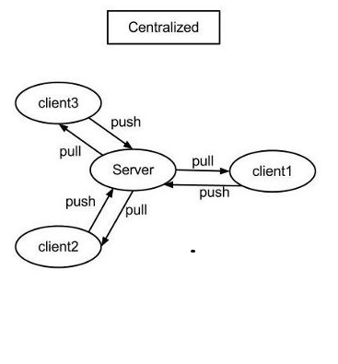
Centralised Vs Decentralised
World Wide Web is built on centralized architecture
All nodes connect to central node
Single point of failure, scaling and inefficiency

Slide 11
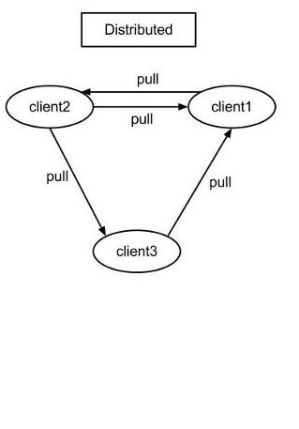
Centralised Vs Decentralised cont..
P2P Network
All nodes are equal
Blockchain follows peer to peer model where all nodes are equal

Slide 12
Value and Asset Management
VALUE
Bitcoin represents value. You can exchange for fiat currency in the crypto exchange.
Many companies accept bitcoins as payment - Microsoft, subway, Pizzaforcoins, Bloomberg
Bitcoin Blockchain allows only bitcoin as representation of value in the network
But in general, Blockchain allows any asset to be managed in their system as long as the asset can be digitally represented

Slide 13
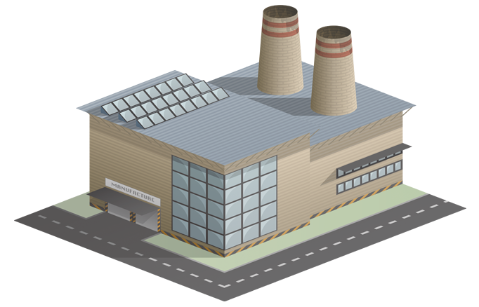
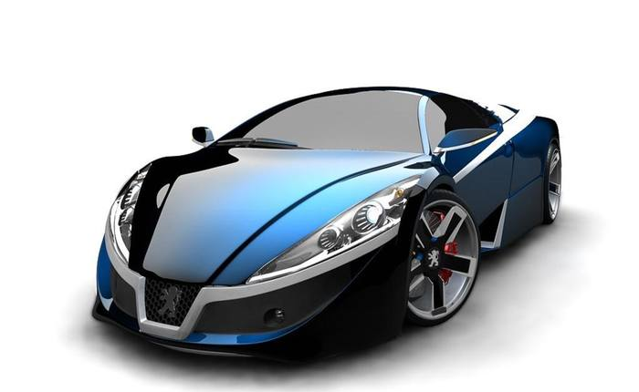


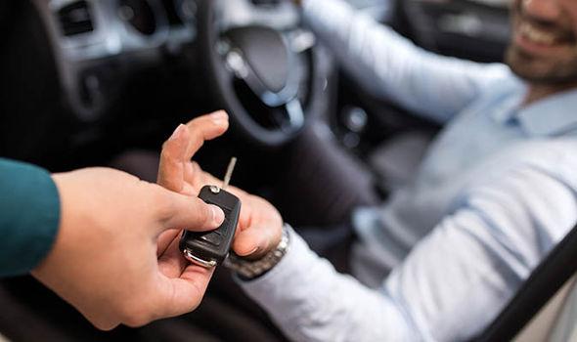
Value and Asset Management
Registers with VIN
Tx Asset Created
Transfer Ownership
Tx Asset Transferred to Dealership
Tx Asset Transferred to Customer
Transfer Ownership
Who owns the car?
History of the car?
Blockchain network

Slide 14
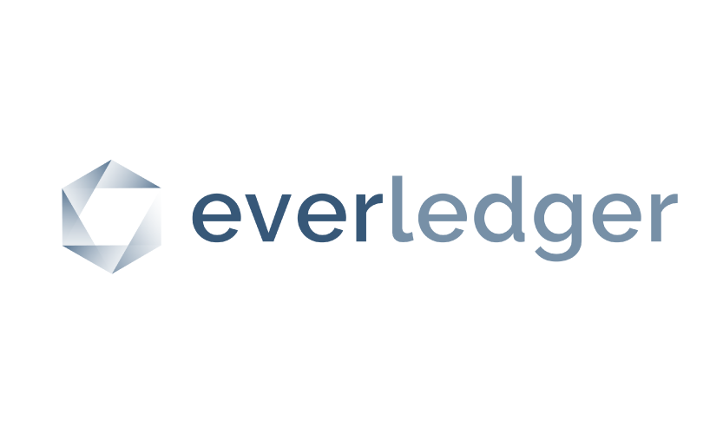
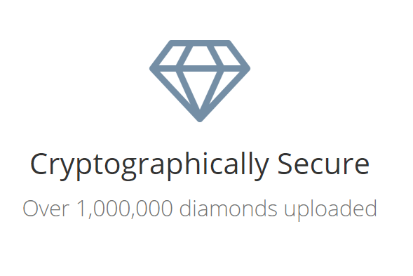
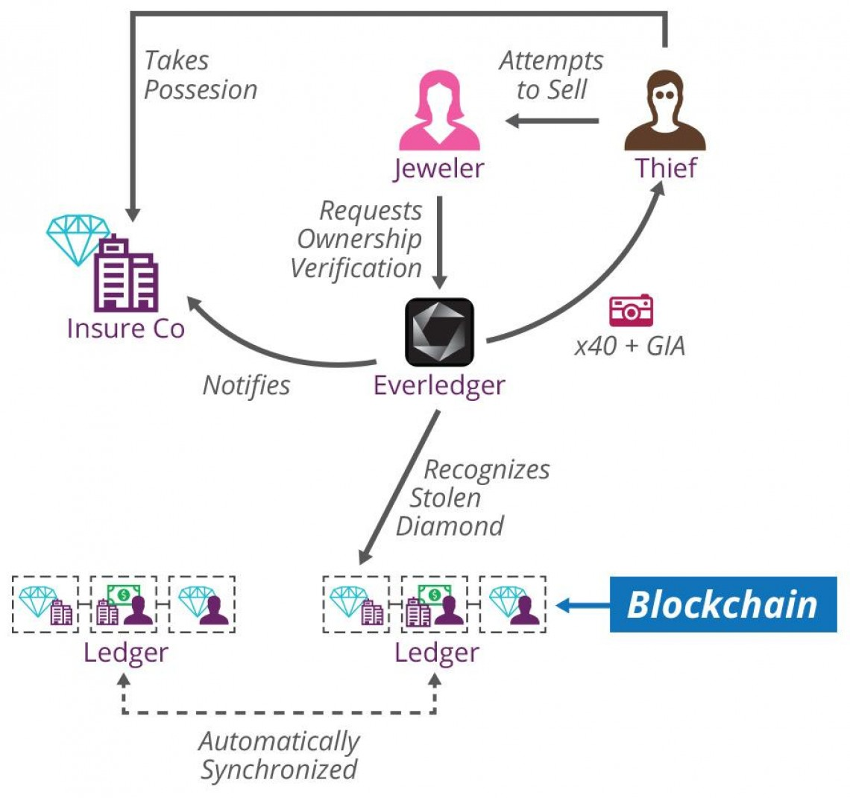
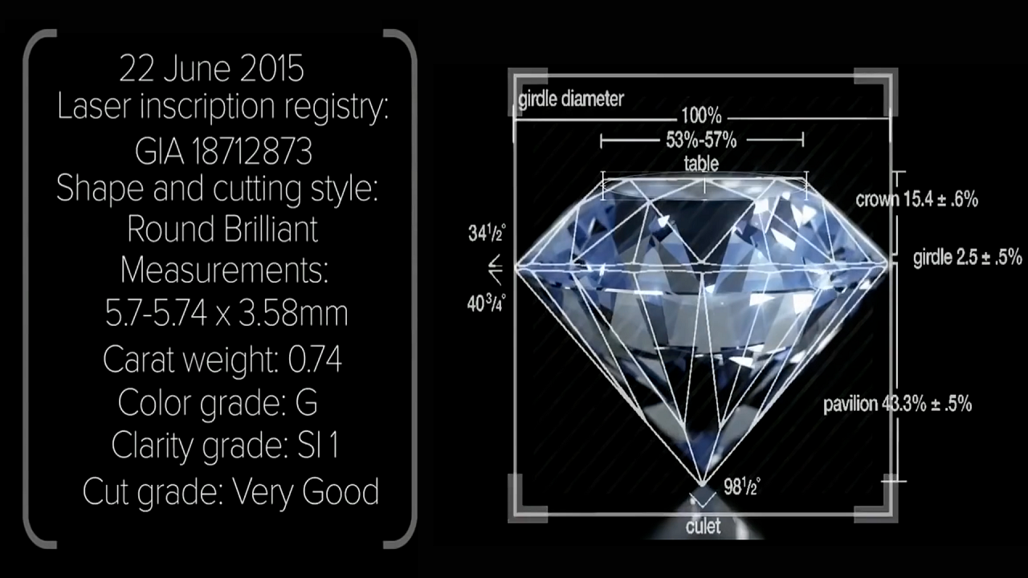
Real-world example
https://www.everledger.io

Slide 15
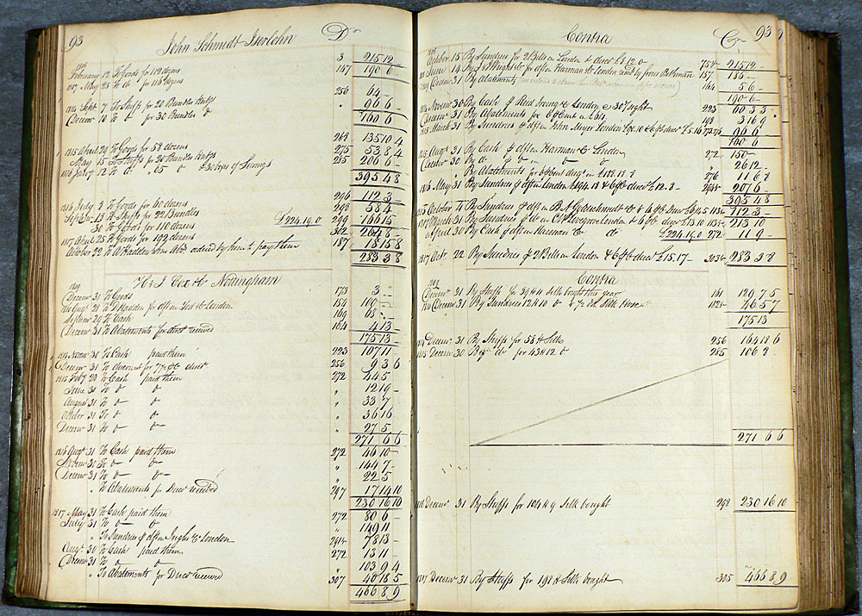



Traditional Ledger vs Distributed Ledger
Traditional Ledger
In Centralized system, the transactions are maintained in central ledger
It is managed and protected by some central authority (Bank)
It is not visible to the outside world
It gets updated when customer carry out some transactions
Ledger
Bank

Slide 16

Distributed Ledger
Peers in the network have the copy of the latest ledger
Peers can use the ledger for reading and initiating the transaction
DLT keeps the data consistent in the network
Nodes in the network can independently validate the integrity of the data in the network
Node doesn’t need to trust any 3rd party/Authority to tell whether the content of leger is valid or not.
Ledger
Ledger
Blockchain network
Ledger
Ledger

Slide 17
DLT - Reconciliation
Bank B
Reconciliation
Intermediaries
Expensive processes
Bank A
Bank C

Slide 18

DLT - Reconciliation
Bank B
Block chain /DLT implemented across enterprises
Bank A
No intermediaries required
Validation can be done by the institutions by their own
Cost saving
Very fast
Very efficient
Less errors
Bank C

Slide 19

R3 Consortium
https://www.r3.com/
https://www.corda.net/
Corda is the open source blockchain
project

Slide 20
Hashing
Cryptographic HASH
It is a digest – Digital fingerprint
SHA256 – Secure Hash algorithm developed by NSA
Any amount of data → fixed length digest /Signature
You can always generate the same fingerprint/digest for the given data
One way function → you can’t generate the data for the given digest/finger print
Demo
https://anders.com/blockchain/hash.html
Anders Brownworth

Slide 21
Blocks and Chaining
Traditional Database – CRUD operation
DLT – Append and Retrieval operation – Once the transaction is added to the ledger it can’t be UPDATED or DELETD
Index 0
Index 1
Index 2
Index n
Timestamp :…
Timestamp :…
Timestamp :…
Timestamp :…
Hash :Block 0
Hash :hash_1
Hash :hash_2
Hash :hash_n
………
Prev Hash:0
Prev Hash:
Prev Hash:
Prev Hash:
Txn..
Txn..
Txn..
Txn..
Txn..
Txn..
…..
…..
…..
Data :…
Txn..
Txn..
Txn..
Block # 0 /Genesis block
Block # 1
Block # 2
Block # n

Slide 22
Immutability
Index 85
Index 86
Index 87
Index 88
Index 89
Timestamp :…
Timestamp :…
Timestamp :…
Timestamp :…
Timestamp :…
Hash :hash_85
Hash :hash_86
Hash :hash_87
Hash :hash_88
Hash :hash_89
Prev Hash:
Prev Hash:
Prev Hash:
Prev Hash:
Prev Hash:
Txn..
Txn..
Txn..
Txn..
Txn..
Txn..
Txn..
Txn..
Txn..
Txn..
…..
…..
…..
…..
…..
Txn..
Txn..
Txn..
Txn..
Txn..
Tampered stop
Prevhash#89 == hash#88
Prevhash#88 == hash#87
Validate
Calculate Hash #88
Calculate Hash #87

Slide 23


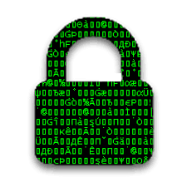

Cryptography
Public key cryptography is the basis for Blockchain technology
Each account owner or participant generate pubic /private key pair to participate in the block chain
A transaction is signed by owner using his/her/its private key
Anyone can validate the transaction with owner’s public key
HASH
HASH
SHA 256
HASH
Seller
TXN Data
Buyer

Slide 24
Blocks and Chaining
Distributed Ledger = Distributed Database
We must ensure the data is consistent across the network. Same data is seen across the network with zero or minimal lag without any authority controlling it
Consensus = protocol by which peers agree on the state of ledger
This is to ensure all peers in the network has exactly same copy of ledger
Fraudulent transactions kept out of ledger
Guarantees the chronological order of the transactions
Types of Consensus protocol
1.Proof of work
2.Proof of stake
3.RAFT
4.PBFT – Practical Byzantine Fault tolerance

Slide 25
Consensus
It is the process by which the Blockchain network is secured & by which new blocks are created and added to the chain.
One of the nodes validate the transactions in the network and create the block . This process is well defined and dictated by the Blockchain protocol
The other nodes reach a consensus on whether to include the block in the chain or rejected
Incentive driven model – Mining process
The nodes which validates the transaction and creates the block gets rewarded
Transactions in the Blockchain network is not free . There is a fee involved .Validating node gets that fee as well.

Slide 26

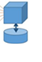
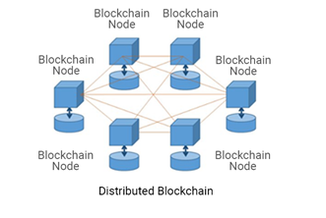
Consensus – Proof of work
Puzzle solution - NONCE
Proof of work
Solve puzzle
Index 85
Timestamp :…
Hash :hash_85
Prev Hash:
Txn..
Txn..
…..
Unconfirmed Transactions
Txn..
Validate

Slide 27
Consensus – Proof of stake
Node to validate selected by the network – No Competition
Stake – Refers to wealth that user holds on the network
Node – Validator / Non miner
Validator will complete the validation & blocks get added
Why Proof of stake?
Reduced energy consumption
Stake in the network will promote good behaviour
Punishment as part of the protocol will act as deterrent
No more news on stealing computational power for mining

Slide 28
Ethereum
Permission less public Blockchain network like Bitcoin
Bitcoin → Distributed data storage
Ethereum →Distributed storage and Computing resources
HISTORY
Bitcoin network doesn’t allow any kind of scripting or code to run on the nodes
2013: Vitalik Buterin argued for supporting scripting on Bitcoin network
White paper :- A Next- Generation Smart contract and Decentralized Application Platform
2014: Vitalik and Gavin wood co-founded Ethereum
Gavin : A secure Decentralized Generalised Transaction Ledger
2015 : Frontier version launched : July 30th
May 2015: Olympic (Testnet)
Jul 2015 : Frontier
Mar 2016: Homestead

Slide 29

Smart Contracts
Smart Contract is the computer code , that lives in the nodes of the network
Enforces the rules agreed by the participants
Contracts can perform negotiated action
In short contract holds the code that implements rules and actions
Contract can be written in multiple languages
2 .Holds Ethers in escrow
3 .Notification Ether received
1 .Sends Ethers
4 .Goods shipped
5 .Goods received
5 .Release fund to seller

Slide 30
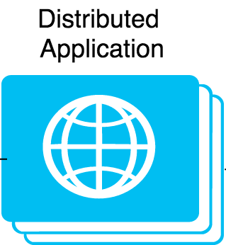
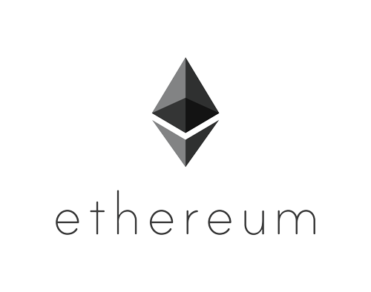
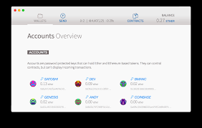
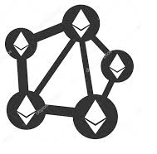
How does it work?
Wallet for managing Ethers
Smart contracts
Decentralized Apps (DAPP)
Interact with contracts on n/w

Slide 31
DAO/DAC
Collection of smart contracts
They are all self executing immutably /Automatically in a Blockchain
Organization is a collection of agreements – different parties has different things to do .
Replacing agreements with smart contract that is nothing but replacing the organization with DAO
This leads to man machine interaction – IOT

Slide 32
Uber
Uber is device that allows you to book a car for yourself using a mobile app
Driver comes and you reach the destination
Mobile app processes the payment
Now fit in the AI to this equation – Self driving Car
Let everything be in Blockchain – Automation to the fullest
Is this DAO?

Slide 33
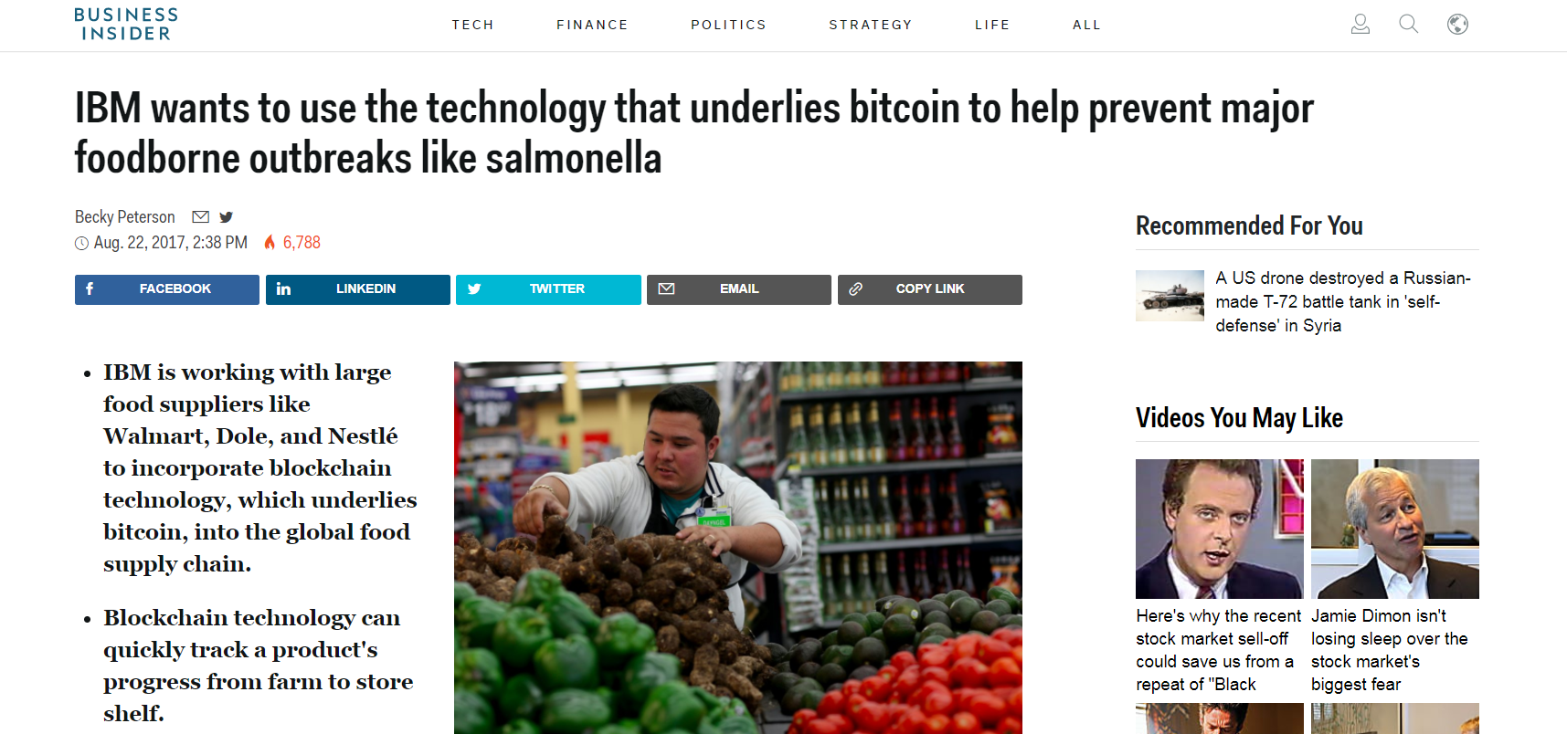
Other Interesting Projects
Walmart supply chain management in partnership with IBM
Tracking pork products across China
Reduced the time it takes to track food from days to minutes
1% of reduction in food borne disease in USA = $700 B saving
48 M people in USA become ill from food borne diseases

Slide 34
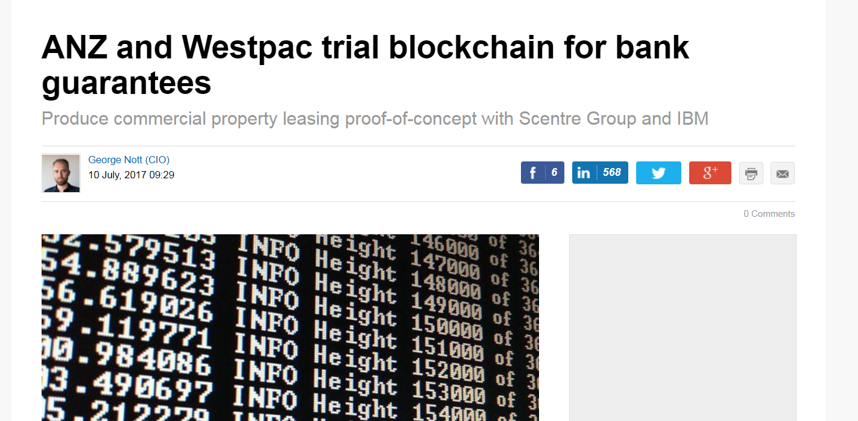
Real Estate
ANZ and Westpac
Partnership with IBM
Use case : Digitized Commercial property lease guarantees
Increased transparency
Reduced Risk, Error and Fraud

Slide 35
Insurance
Maersk
Partnership with MS
Shipping insurance – 20 WK proof of concept
Make auditing aspects of shipping supply chain easier
Improve tamper resistance
Sharing of data in real-time

Slide 36
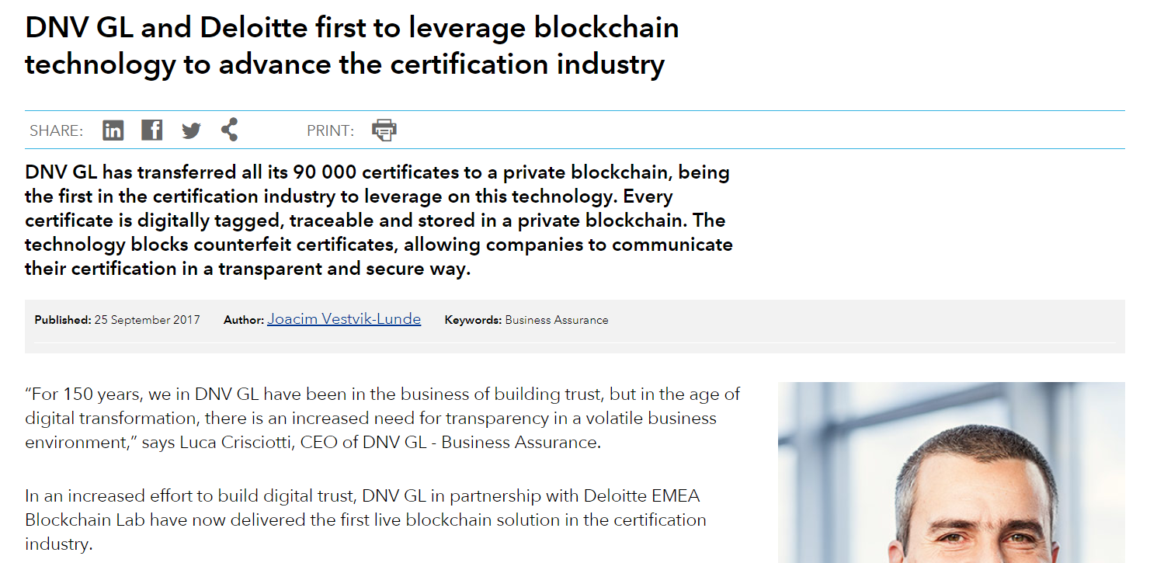
Certificates of Authenticity
In partnership with Deloitte
Instant verification of certificate
90,000 certificate
Improve tamper resistance
Reduce fraud and counterfeiting

Slide 37
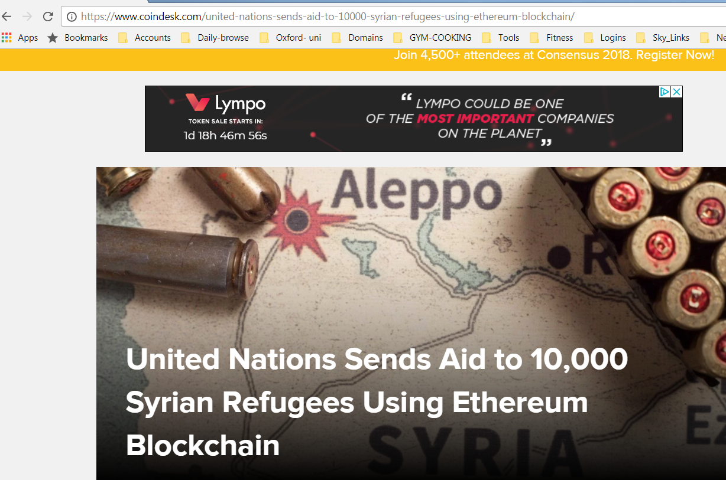
Humanitarian aid
UN world food programme
Uses Ethereum to Aid Syrian Refugees
10,000 Syrian refugee living in the Azraq camp in Jordan
Increased transparency

Slide 38
Key Project
Decentralised autonomous Assisted Living

Slide 39
What next?

Slide 40
Try Downloading Ethererum Node and Wallet
Visit etherscan.io
Inspect the blocks generated and content of the block
Distinguish between Contract invocation and Ether transfer
Look into some real-time Contracts and understand how they work
Visit Ethereum Blog

Slide 41
Thank You!

